Slide 1

Chapter 2:system simulation

Slide 2
System simulation
System simulation – the technique of solving problems by the observation of the performance over time, of a dynamic model of the system
Not only the time constraint, but randomized selection in a step-by-step transition system is also considered as system simulation

Slide 3
2.1 The Simulation Techniques
Simulation techniques are methods used to imitate real-world processes or systems over time using computer models to analyze behavior, optimize performance, and support decision-making.
Key approaches include Discrete-Event (individual events), Continuous (smooth changes), Agent-Based (autonomous actors), and Monte Carlo (stochastic/random sampling) simulations

Slide 4
The Simulation Techniques
Discrete-Event Simulation (DES): Models systems as a series of distinct events over time, such as queuing systems in banks or manufacturing lines.
Continuous Simulation: Used when system states change continuously over time, often described by differential equations (e.g., flight simulators, chemical reactions).
Agent-Based Simulation (ABS): Focuses on modeling autonomous "agents" (individuals) and their interactions with each other and their environment to observe emergent behavior.
Monte Carlo Simulation: Uses random sampling to estimate the probability of different outcomes, commonly used for risk analysis, financial modeling, and complex systems with high uncertainty.
System Dynamics: Focuses on policy analysis and understanding the high-level, aggregate behavior of systems over time, utilizing feedback loops and stock-and-flow structures.
Hybrid Simulation: Combines multiple techniques, such as discrete-event and agent-based, to model complex, multi-layered systems.
Parallel/Distributed Simulation: Distributes a simulation model across multiple computer processors to handle high computational loads and reduce simulation time.

Slide 5
2.2 The Monte Carlo Method
Originally used for variable reduction
Uses random numbers as the input sample
Computational technique applied to static models
Define a function and select random numbers
Test the function against the random numbers
The good accuracy can be achieved by increasing the number of random samples

Slide 6
2.3 Simulation vs. Analytical methods
Simulation gives specific solution for given set of data whereas analytical method gives solution for all of the conditions
To find the general solution, the simulation needs to be repeated many times
For analytical study, the system should be modeled by using some specific format - Simulation consists of lots of step by step execution.
If the simulation is run for several times, then there will be increase in detail complexity
Ideal way for simulation-use extension of mathematical soln

Slide 7
2.4 Experimental Nature of Simulation
Simulation: observe the way in which all variables of the model change with time
Instead of using analytical solutions, a system might be tested against lots of input samples and the output is observed
The relationship between input and output can be discovered Requires lots of simulation runs
Popular in system study
Must be planned as a series of experiments

Slide 8
Distributed lag model
If the regression model includes not only the current but also the lagged (past) values of the explanatory variables ( the x’s) is called distributed lag model . If the model includes one or more lagged values of the dep endent variables among its explanatory variables , it is called auto regressive model. This is known as dynamic model .
In other words , distributed lag model is defined as a type of model that have property of changing only at fixed interval of time and based on current values of variables on other current values pf variables and values that occurred in previous intervals.
In economics studies , some economic data are collected over uniform time intervals such as month or year . This model consist of linear algebraic equation that represent the but data are avialble at fixed point in time.

Slide 9
For example : model of national economy
Let,
C be consumption,
I be investment,
T be taxes,
G be government expenditure and Y be national income.
THEN
C=20+0.7(Y-T)
I=2+O.1Y
T=0+0.2Y
Y=C+I+G

Slide 10
For example : model of national economy
All quantities are expressed in billions of rupees. This is a static model, but it can be made dynamic by picking a fixed time interval, say one year, and expressing the current values of the variables in terms of values of the previous year. Any variable that appears in the form of its current value and one or more previous year’s values is called lagged variables. Value of the previous year is denoted by the suffix with-1
The static model can be made dynamic by lagging all the variables, as follows;
C=20+0.7(Y₋₁-T₋₁)
I=2+O.1Y₋₁
T=0+0.2Y₋₁
Y=C₋₁+I₋₁+G₋₁
In these equations if values for the previous year (with –1 subscript) is known then values for the current event can be computed. Taking these values as the input, values for the next year can also be computed.

Slide 11
ADVANTAGES
Simple to understand and can be computed by hand , computers are extensively used to run them.
There is no need for a special programming language to organized the simulation task.

Slide 12
2.6 Computation Techniques for Continuous Models
Analytical Techniques
Analytical techniques are used to obtain exact mathematical solutions of continuous systems using mathematical methods
Differential equations
Laplace transform
Numerical Techniques Numerical techniques are used to find approximate solutions of continuous systems when exact analytical solutions are difficult or impossible
Finite Difference Method (FDM)Finite Element Method (FEM)
Euler Method
Runge-Kutta Method
Taylor Series Method
Simulation Techniques
Simulation techniques are used to imitate the behavior of real-world continuous systems using computer models over time
CSMP (Continuous System Modeling Program)
MATLAB / Simulink
Computer-based modeling

Slide 13
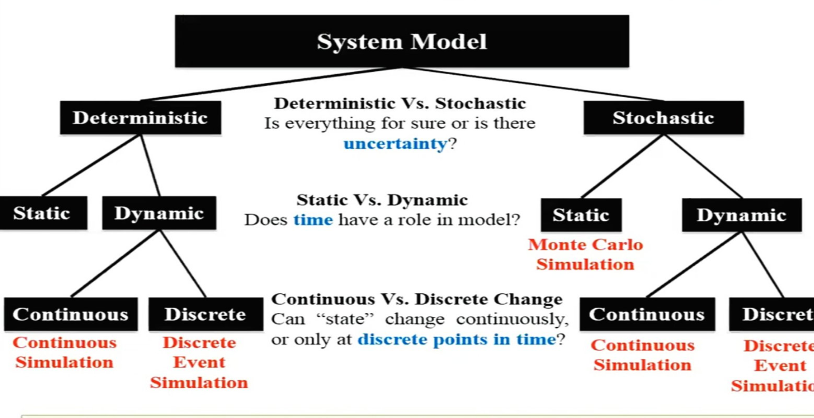
2.5 Types of System Simulations

Slide 14
Static vs. Dynamic: Static models represent systems at a specific point in time (no time element), while dynamic models represent systems as they change over time. Static models are generally simpler and quicker to construct, suitable for design and decision-making. Dynamic models are more complex, requiring in-depth analysis of transient behavior. Static simulations are ideal for financial modeling or probability analysis, while dynamic simulations are used for operational scenarios, such as manufacturing, traffic flow, or chemical process controls
Deterministic vs. Stochastic: Deterministic models have no random components, meaning the same input always produces the same output. Stochastic models incorporate random variables and uncertainty.
Deterministic simulations are built on fixed mathematical relationships where randomness is entirely excluded. In this model, the output is fully determined by the parameter values and the initial conditions, meaning that if you run the same simulation multiple times with the same inputs, you will always achieve the exact same result. These are ideal for systems governed by strict physical laws or predictable logic where uncertainty is negligible.
Stochastic simulations, on the other hand, incorporate random variables to represent the uncertainty and "noise" of the real world. Because these models use probability distributions rather than fixed values, each run of the simulation can produce a different outcome even if the starting inputs remain unchanged. This approach is essential for modeling complex systems like traffic flow, financial markets, or service queues, where predicting a range of possible outcomes and their likelihood is more valuable than finding a single, rigid answer.
Physical vs. Logical: Physical models are tangible representations, whereas logical/mathematical models use equations and computer algorithms.

Slide 15
2.7COBWEB MODEL
The cobweb model or cobweb theory is an economic model that explains why prices may be subjected to periodic fluctuations in certain types of markets. It describes cyclical supply and demand in a market where the amount produced must be chosen before prices are observed.
Cobweb theory is the idea that price fluctuations can lead to fluctuations in supply which cause a cycle of rising and falling prices.
In a simple cobweb model, we assume there is an agricultural market where supply can vary due to variable factors, such as the weather

Slide 16
Assumptions of Cobweb theory
In an agricultural market, farmers have to decide how much to produce a year in advance before they know what the market price will be. (supply is price inelastic in short-term)
A key determinant of supply will be the price from the previous year.
A low price will mean some farmers go out of business. Also, a low price will discourage farmers from growing that crop in the next year.
Demand for agricultural goods is usually price inelastic (a fall in price only causes a smaller % increase in demand)

Slide 17
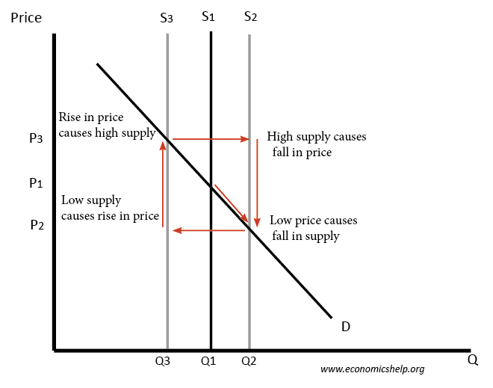

Slide 18
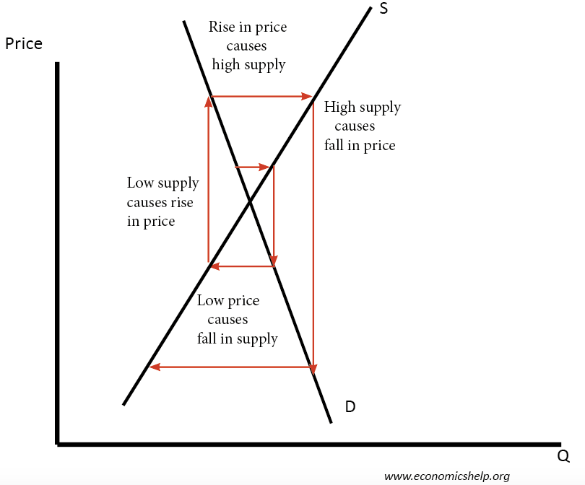
Cobweb theory and price divergence
Price will diverge from the equilibrium when the supply curve is more elastic than the demand curve, (at the equilibrium point)
if the slope of the supply curve is less than the demand curve, then the price changes could become magnified and the market more unstable.

Slide 19
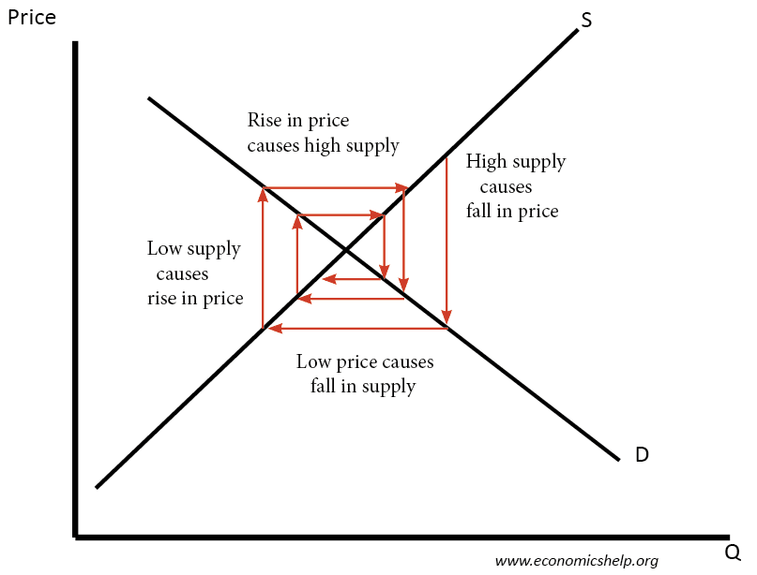
Cobweb theory and price convergence
At the equilibrium point, if the demand curve is more elastic than the supply curve, we get the price volatility falling, and the price will converge on the equilibrium

Slide 20
Limitations of Cobweb theory
Rational expectations. The model assumes farmers base next years supply purely on the previous price and assume that next year’s price will be the same as last year (adaptive expectations). However, that rarely applies in the real world. Farmers are more likely to see it as a ‘good’ year or ‘bad year and learn from price volatility.
Price divergence is unrealistic and not empirically seen. The idea that farmers only base supply on last year’s price means, in theory, prices could increasingly diverge, but farmers would learn from this and pre-empt changes in price.
It may not be easy or desirable to switch supply. A potato grower may concentrate on potatoes because that is his speciality. It is not easy to give up potatoes and take to aubergines.
Other factors affecting price. There are many other factors affecting price than a farmers decision to supply. In global markets, supply fluctuations will be minimized by the role of importing from abroad. Also, demand may vary. Also, supply can vary due to weather factors.
Buffer stock schemes. Governments or producers could band together to limit price volatility by buying surplus

Slide 21
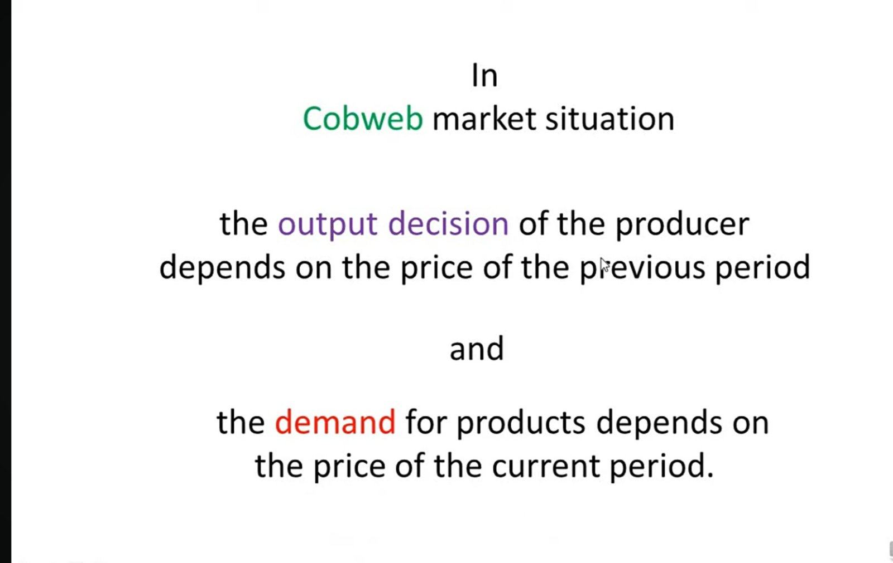

Slide 22
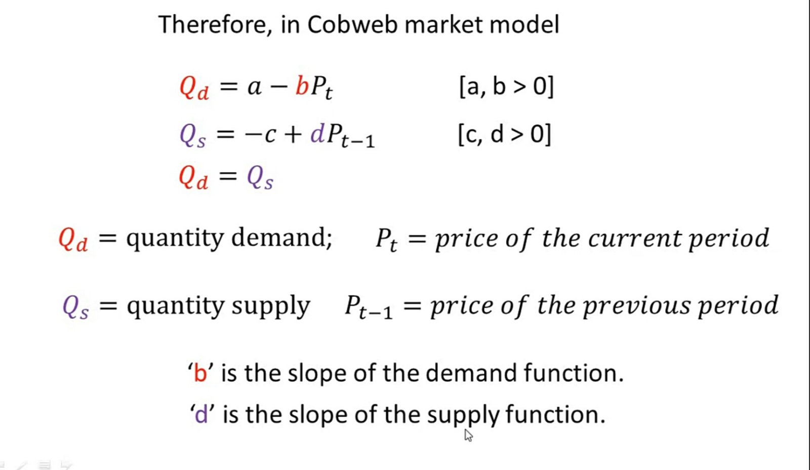

Slide 23
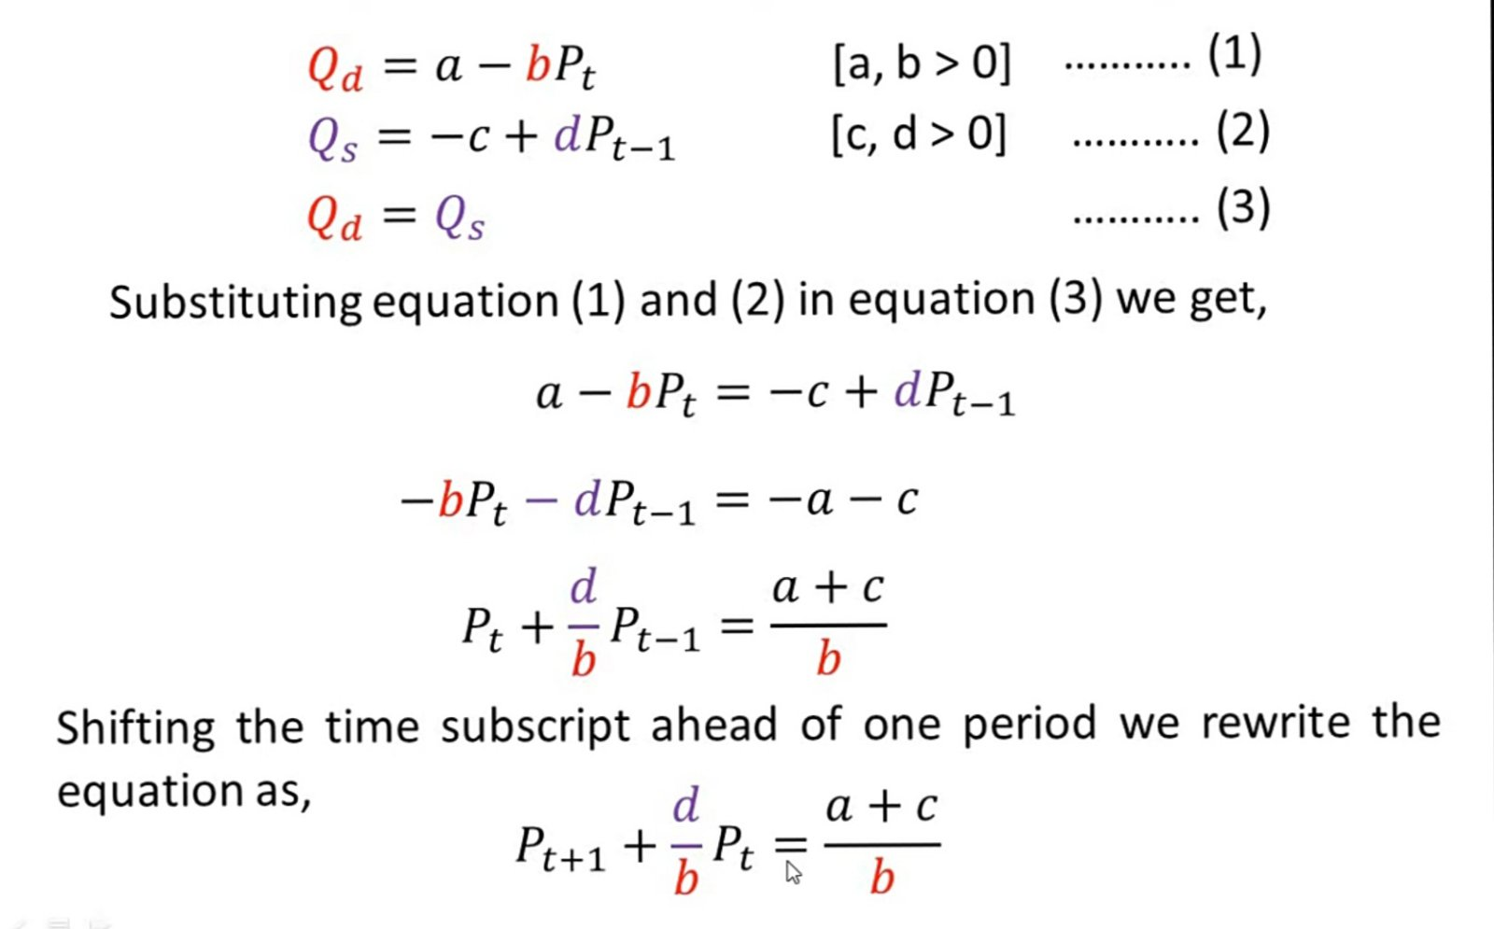

Slide 24
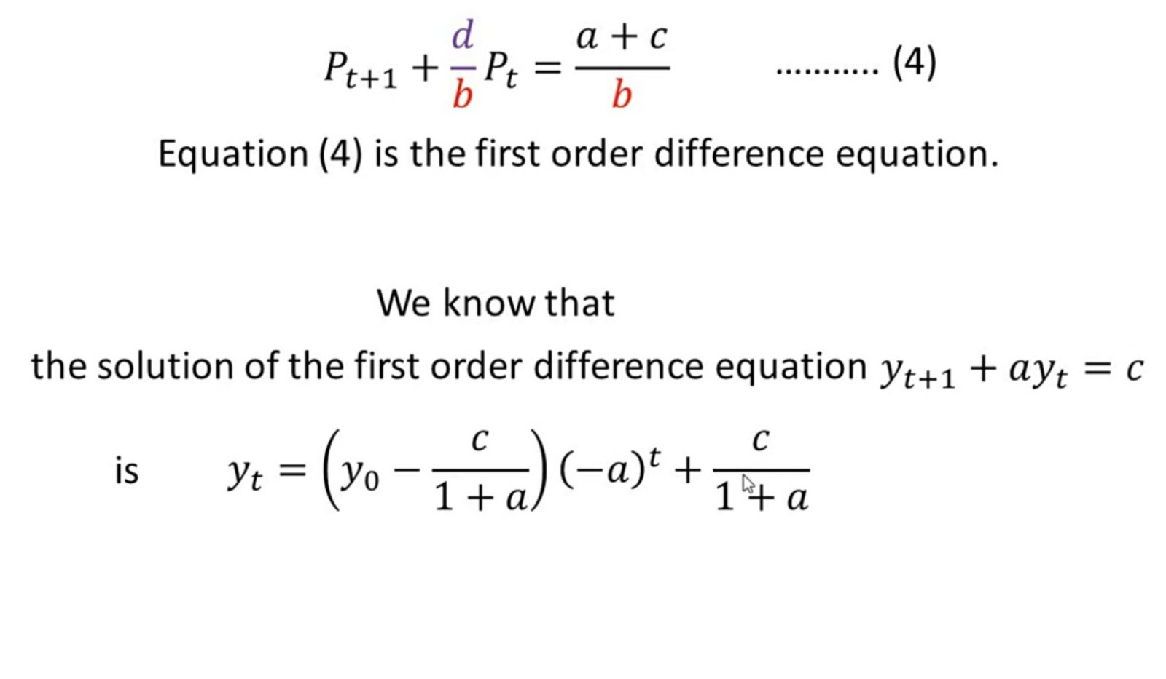

Slide 25
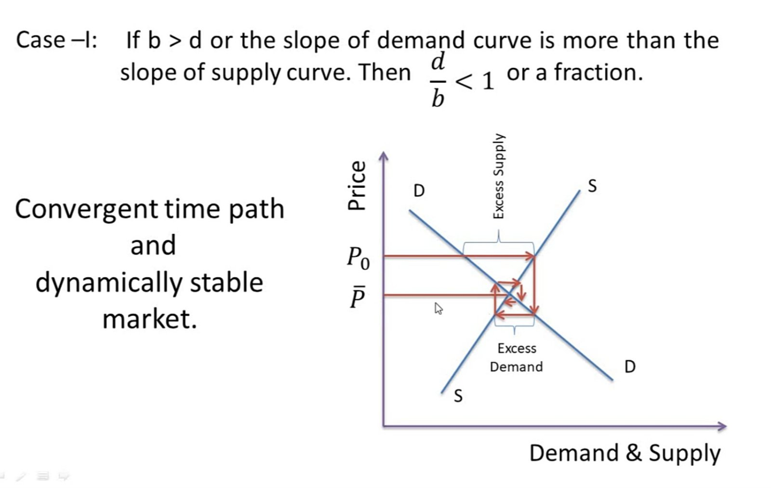

Slide 26
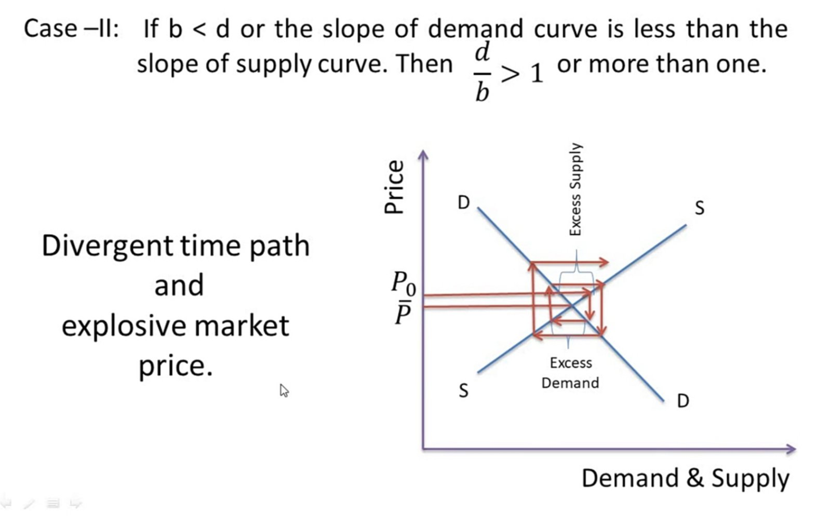

Slide 27
